Slide 2
Digital Media Project
Student’s Name

Slide 4
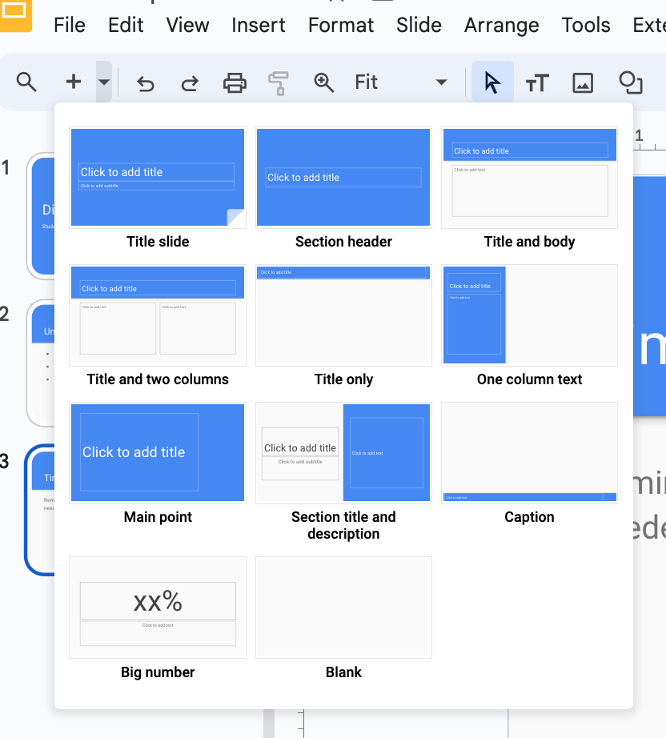
Unknown Words or Phrases:
On the next slide, you will fill in your unknown words or phrases and define them.
If needed, you can create a new page to add more words or phrases by clicking the + in the top left hand corner and selecting which page you want to add.
Delete this page when you’re done.

Slide 5
Unknown Words or Phrases:
Unknown Word/Phrase
Definition
Unknown Word/Phrase
Definition
Unknown Word/Phrase

Slide 6
Timeline
Reminder - Each timeline only allows 6 events per page.
Follow the directions on the next page to add your timeline.
Add pages to ensure your timeline is complete.
Delete this page when finished.

Slide 7
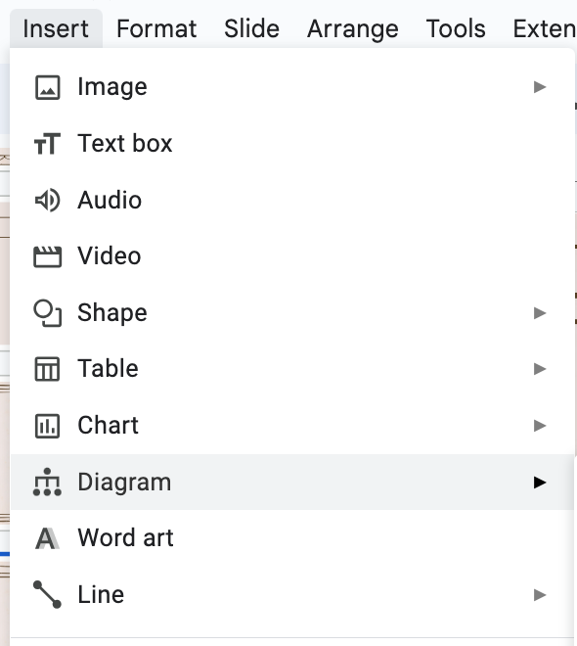
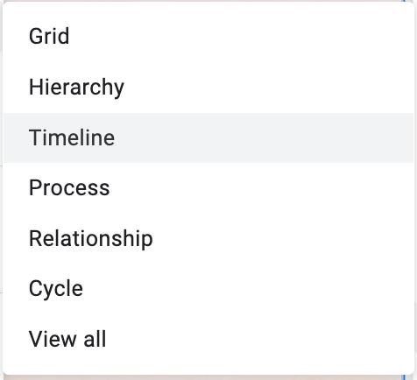
How to Make a Timeline:
Choose the correct page which correlates to your assigned paragraph.
Click Insert then click Diagram.
Select Timeline.
You may choose up to 6 events for your timeline.
Delete this page when finished.

Slide 8
Timeline:

Slide 9
Pop Quiz!
Reminders:
10 total questions
8 multiple choice
2 written response
Must include information from the whole text and timeline
Delete this page when finished.

Slide 10
Pop Quiz!
Question 1:

Slide 11
Pop Quiz!
Question 2:

Slide 12
Pop Quiz!
Question 3:

Slide 13
Pop Quiz!
Question 4:

Slide 14
Pop Quiz!
Question 5:

Slide 15
Pop Quiz!
Question 6:

Slide 16
Pop Quiz!
Question 7:

Slide 17
Pop Quiz!
Question 8:

Slide 18
Pop Quiz!
Question 9:

Slide 19
Pop Quiz!
Question 10:

