Slide 2
..
Pe-ah-in
(Mother)
Resistance & Rebellion
Carlisle Indian School
Plains Indians- Forced Migrations, Stories Remembered

Slide 3
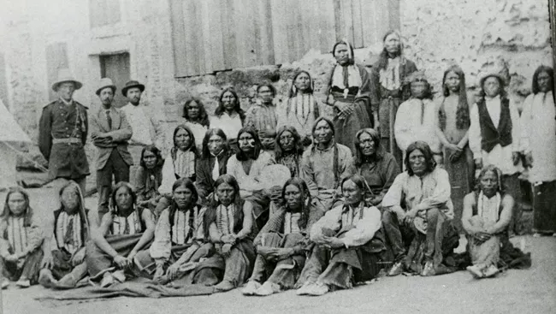
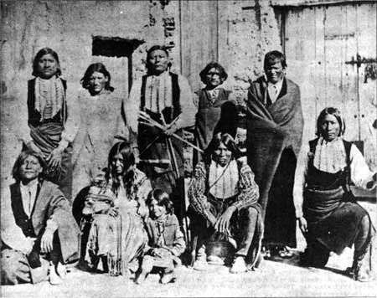
Return to Museum
Image of “Artifact 1” Here
Image of “Artifact 3” Here
. .
Image of “Artifact 2” Here
. .
Pe-ah-in was the wife of Black Horse. She refused to leave his side and brought their six-year old daughter, Ah-kes, with her to Fort Marion when Black Horse was imprisoned by the United States. The two were the only non-prisoner Plains Indians to remain at the Fort.
. .
Pe-ah-in (Mother)

Slide 4
Return to Exhibit
Photograph of the family
This photograph shows Black Horse with Pe-ah-in and Ah-kes in their traditional clothing at Fort Marion. The two family members were the only ones who were not imprisoned at the Fort. Like the prisoners, they were also Anglicized during their time at the Fort. Local St. Augustine women helped teach them English and would often dress them in western dresses. Ah-kes learned to write in English and wrote a letter to the President asking for her people’s freedoms.
Put artifact image or video here.

