Slide 1
EPITAPH INTRO
© 2018 UCF

Slide 2
WHAT IS AN EPITAPH?
A statement or description on a tombstone that is a personalized memory or quote for the person
Can be funny, biographical, or serious

Slide 3
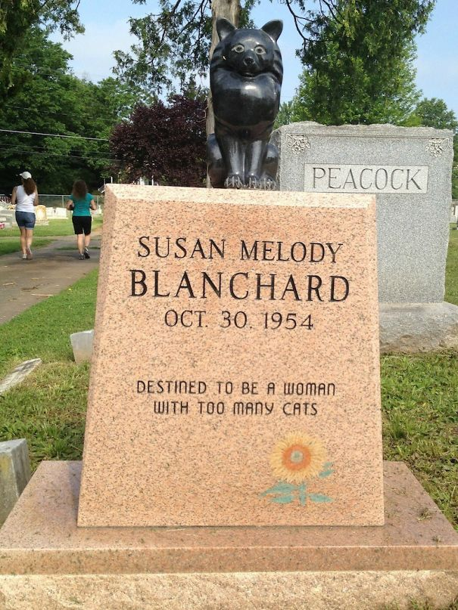

Slide 4
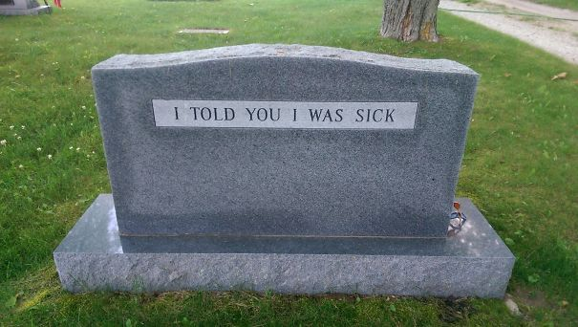

Slide 5
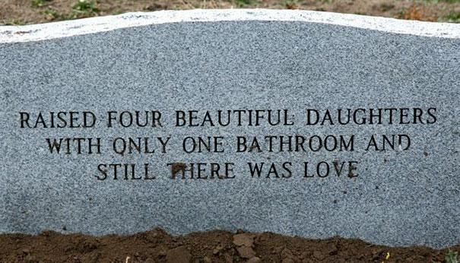

Slide 6
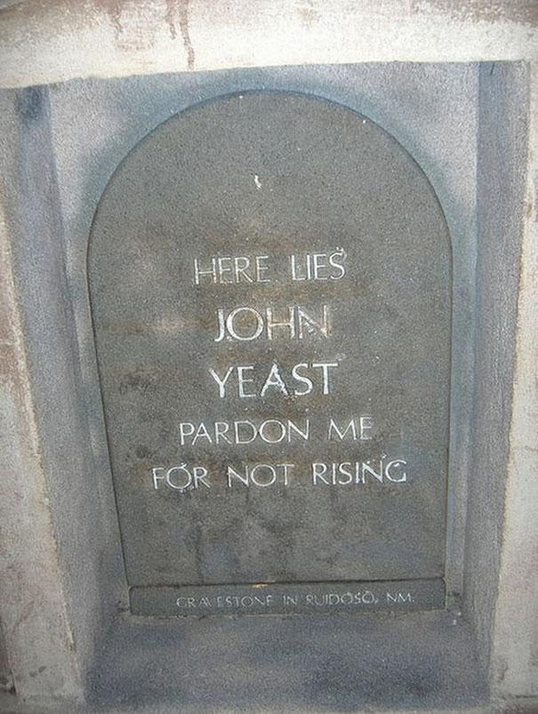

Slide 7
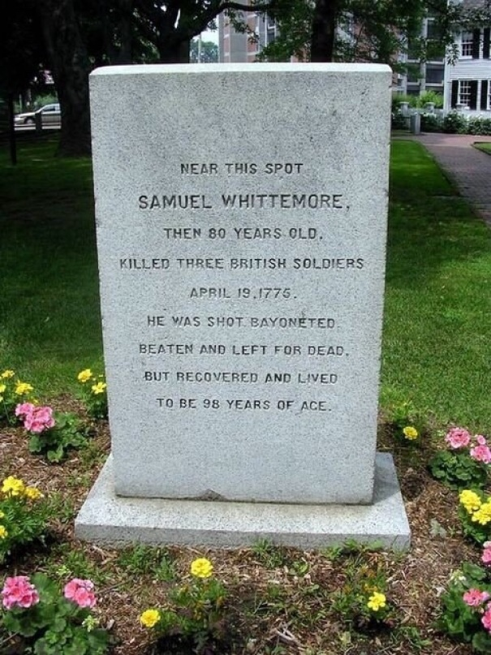

Slide 8
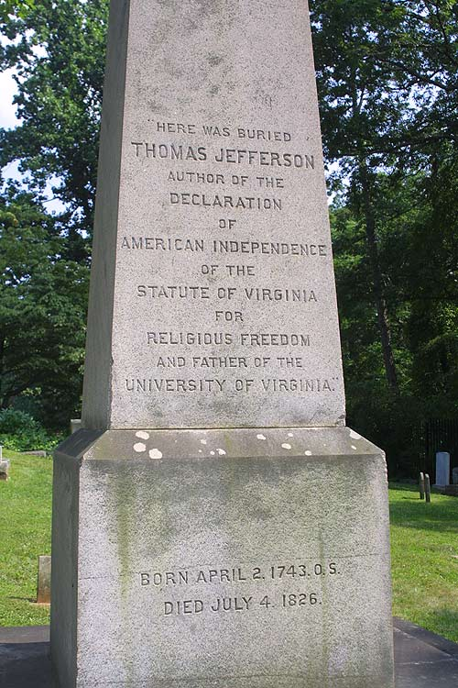

Slide 9
YOUR TURN
Think of your favorite fictional character – can be from a book, movie, or TV show – and write a funny epitaph for them.

Slide 10
WORKS CITED
Lynaugh, Mike. “Charlottesville - The Gravesite of Thomas Jefferson. ” The Grave of General Stonewall Jackson in Lexington, VA.The Grave of General Stonewall Jackson in Lexington, VA., Mike Lynaugh, www.mikelynaugh.com/Charlottesville/pages/IMG_8621.htm.
Marc, Sarune. “50+ Brilliant Tombstones By People Whose Sense Of Humor Will Live Forever.” Bored Panda, Bored Panda, 2018, www.boredpanda.com/funny-tombstones-epitaphs/?page_numb=2.

